Slide 1
What We Have so Far
Nam Thach
Reid Stancu

Slide 2
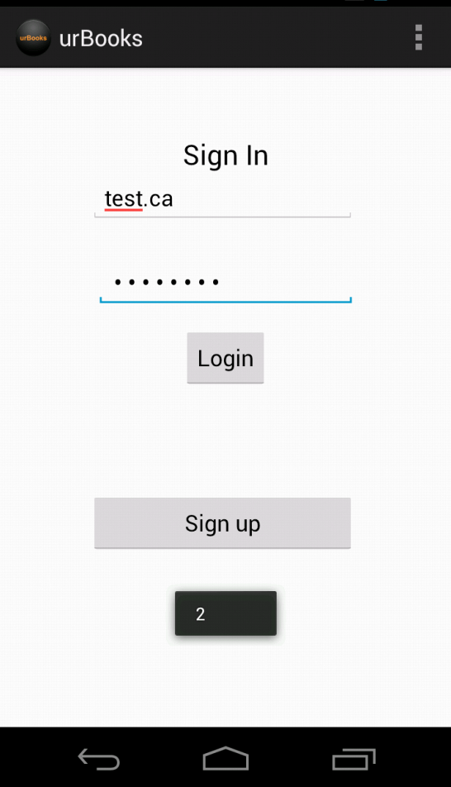
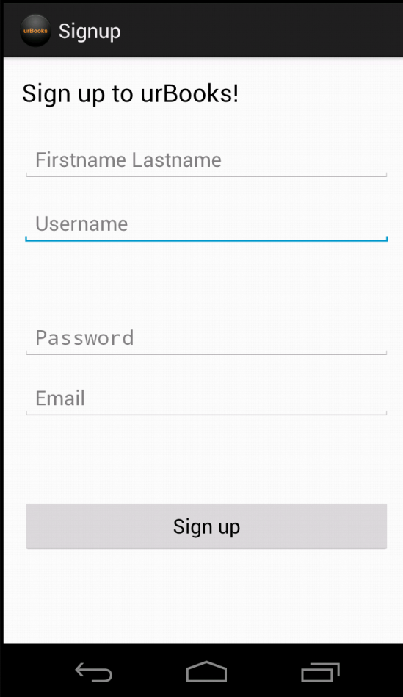
Android Side

Slide 3
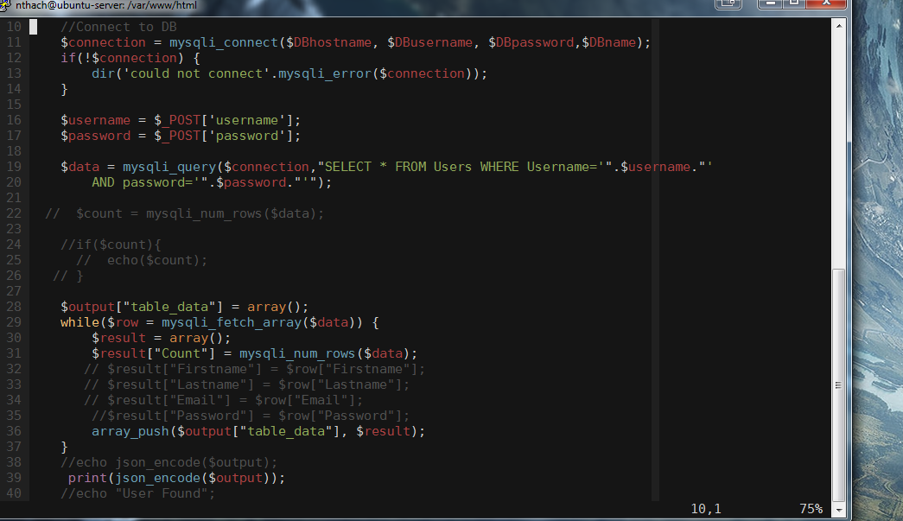
Server Side

Slide 4
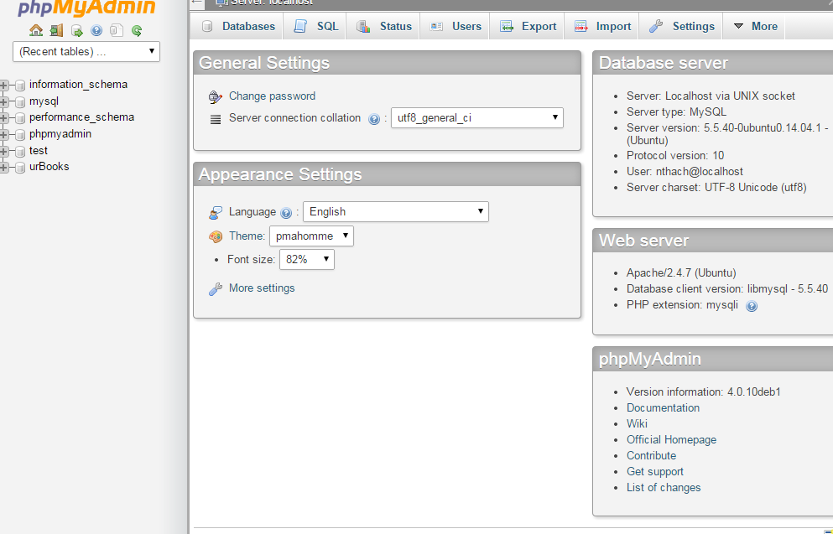
Continued

